Slide 1

Physical Health & Nutrition
Week 12
Notes:
Designed and created by Dandi Yang. Do not duplicate or upload with the express written permission of the author.

Slide 2
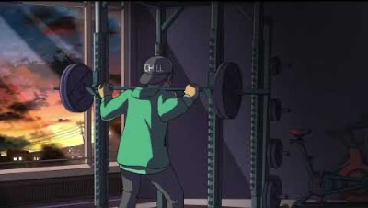
Notes:
Before we begin, please feel free to open up this video, keep in the background and and enjoy some chill, lo-fi beats as you navigate through this lecture. Or watch the video in between work sessions to destress and refocus.

Slide 3

Overview
Stress and Nutrition
Healthy Eating Habits
Eating Disorders
Exercise and Physical Fitness
Benefits of Exercise
Stretching and Stress Relief

Slide 4


Stress and Nutrition
Stress influences health both directly and indirectly
Exercise, and sleep
Engaging in negative coping behaviours such as drinking, smoking, and drug use
Stress can lead to eating disorders (anorexia nervosa, bulimia)
Eating too much or too little can cause stress
Taking care of your body is an important stress prevention strategy
02
Notes:
A well-nourished body is best prepared to deal with stress. We know now that stress places additional demands on the body, and also that stress can initiatie a wide-variety of altered eating behaviours. We will see today that stress can even create some unique nutritional needs. Nutrition is a great "stress buffer" that can help our bodies to get the necessary energy to deal with our daily stress.

Slide 5
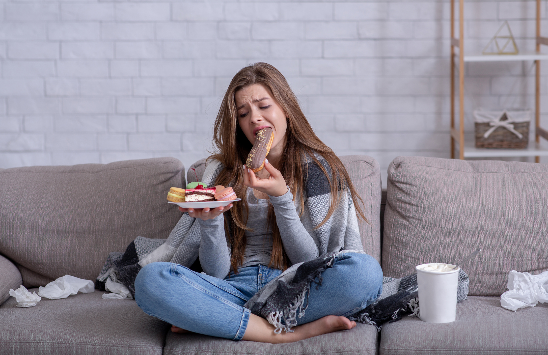
Stress and Nutrition
To be healthy, eat a balanced diet according to Canada’s Food Guide
A balanced diet has a variety of nutrients (carbohydrates, fats, protein, vitamins, minerals, and water)
Maintaining a balanced diet is essential to staying nutritionally healthy
02
Notes:
Stress leads to poor nutritional habits
Results in eating disorders such as anorexia nervosa and bulimia

Slide 6
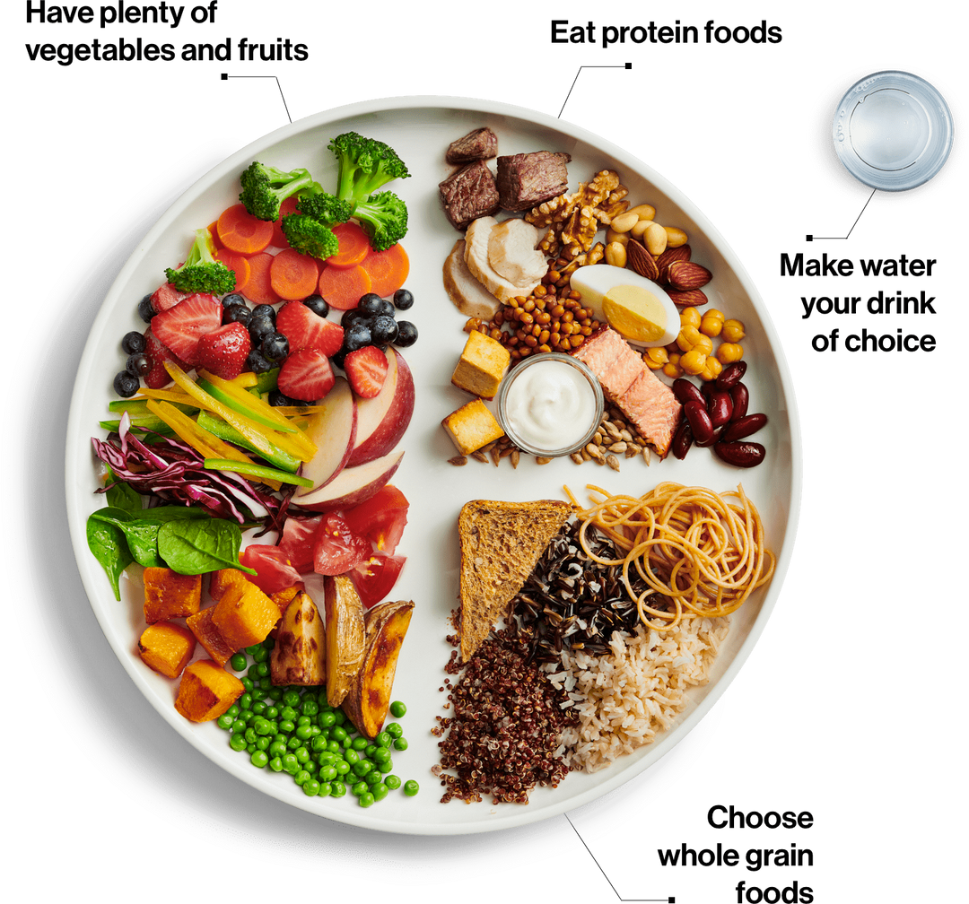

Canada's Food Guide
Eat a variety of healthy foods each day
Notes:
Eat plenty of vegetables and fruits, whole grain foods and protein foods. Choose protein foods that come from plants more often.
Choose foods with healthy fats instead of saturated fat
Limit highly processed foods. If you choose these foods, eat them less often and in small amounts.
Prepare meals and snacks using ingredients that have little to no added sodium, sugars or saturated fat
Choose healthier menu options when eating out
Make water your drink of choice
Replace sugary drinks with water
https://food-guide.canada.ca/en/

Slide 7
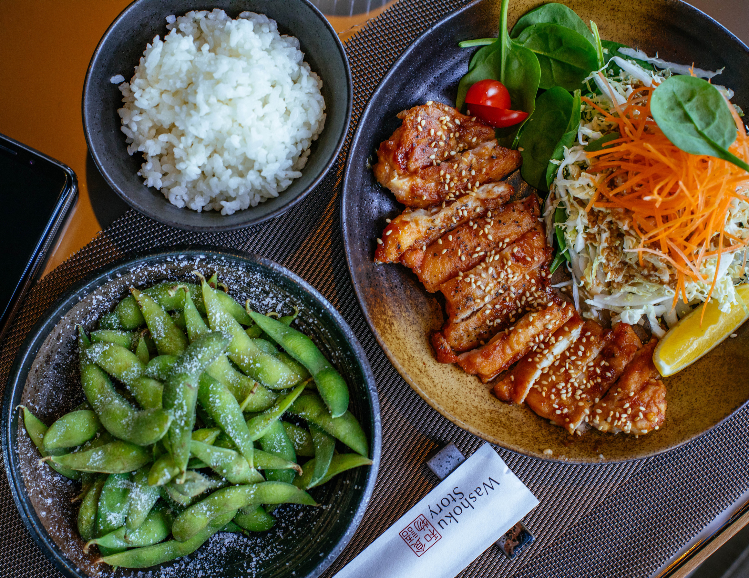
Healthy Eating Habits
Healthy eating is more than the foods you eat. It is also where, when, why and how you eat.
Being mindful can help you:
Make healthier choices more often
Make positive changes to routine eating behaviours
Be more conscious of the food you eat and your eating habits
06
Notes:
Be mindful of your eating habits
Take time to eat
Notice when you are hungry and when you are full
Cook more often
Plan what you eat
Involve others in planning and preparing meals
Enjoy your food
Culture and food traditions can be a part of healthy eating
Eat meals with others
Enjoying healthy foods with family, friends, neighbours or co-workers is a great way to connect and add enjoyment to your life. It can provide many benefits and contribute to a healthy lifestyle.

Slide 8
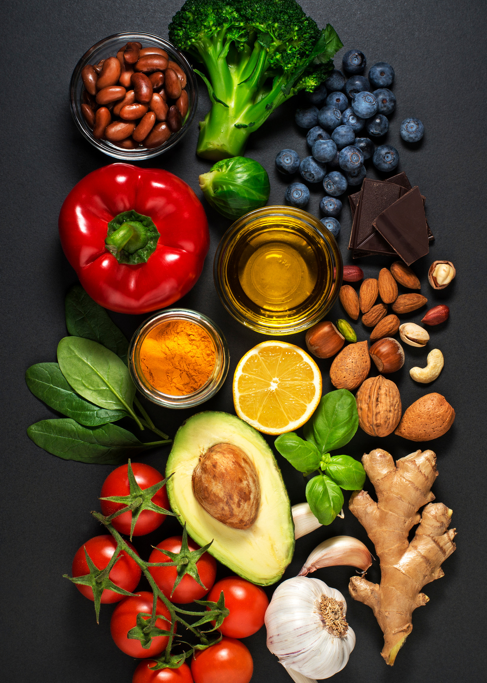
Healthy Food Choices
Use food labels
Using food labels can help you compare and choose products so you can make an informed choice.
Be aware of food marketing
It is important to be aware of marketing because it can influence your food choices.
06
Notes:
Food labels provide information you can use to make informed choices about foods and drinks at the grocery store and at home. Food labels can help you:
compare and choose products more easily
know what ingredients a food product contains
choose products with a little or a lot of the nutrients that are of interest to you
Be aware that food marketing can influence your choices
Food marketing is advertising that promotes the sale of certain food or food products. Many foods and drinks that are marketed can contribute too much sodium, sugars or saturated fat to our eating patterns.
You likely receive a constant stream of changing and often conflicting messages about food. This can make it hard to make healthy food choices.
Teach those who may be more vulnerable to food marketing, like young children and teens, about marketing techniques

Slide 9
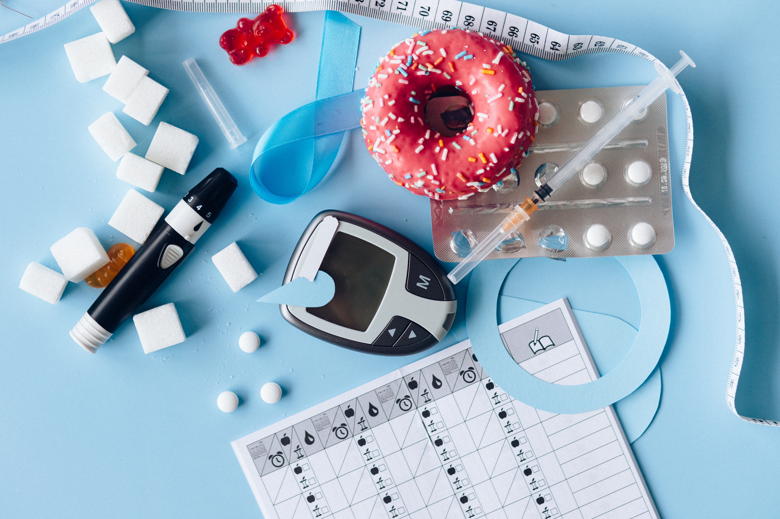
Diet-Related Chronic Diseases
Cardiovascular disease
Found in 37% of the population
Hypertension
25% of Canadian adults have hypertension
That’s 1 in 4 people ages 20-79!
Diabetes
Almost 11% of the population ages 20 and older have diabetes
02
Notes:
Being overweight does increase your risk for developing type 2 diabetes, and a diet high in calories from any source contributes to weight gain. Research has shown that drinking sugary drinks is linked to type 2 diabetes.

Slide 10

Diet-Related Chronic Diseases
Osteoporosis
½ women and ¼ men ages 50 and older will have an osteoporosis-related fracture in their lifetime
Cancer
41% of the population will be diagnosed with cancer during their lifetime
02
Notes:
Diet can also directly affect cancer risk. Some foods, such as processed and red meat and salt-preserved foods, can increase the risk of developing cancer. While others, such as fruits, vegetables and foods high in fibre, can reduce the risk of cancer.
Nutrition, especially calcium, plays an important role in preventing osteoporosis. In people who have healthy bones, adequate calcium intake on a daily basis is necessary to maintain bone health. For older adults, studies have shown that adequate calcium intake can slow bone loss and lower the risk of fracture. Protein is another important nutrient for building and repairing body tissues, including bones.

Slide 11

Stress and Healthy Weight
Obesity is a national epidemic
A leading cause of morbidity and mortality
Can be caused by limited resources
Links between stress and obesity
Eating to cope
Unused glucose
The cortisol connection
02
Notes:
Did you know that stress can make you eat more?! Many people use eating as a coping mechanism, what we call the food/mood connection. Emotional eating is often done without thinking about it and unrelated to hunger. There may be a connection between eating certain foods and the release of substances in the brain that are experienced as soothing.
When healthy options are not available, people may settle for foods that are higher in calories and lower in nutritional value. People in low-income communities and some racial and ethnic groups often lack access to convenient places that offer affordable, healthier foods.
When we eat, our body releases a chemical called dopamine, which makes us feel good and can help offset the pain that we may be feeling from our stressful day. This can help us cope with stress. In addition, when the body experiences the fight-or-flight response, glucose is drawn from stored glycogen and fat. When glucose is not used for physical activity, as happens when we sense a threat but aren’t in any danger, it is stored as fat. This makes us more prone to unhealthy weight gain when we use eating as a coping mechanism for our stress. Lastly, activation of the stress response results in massive secretion of the stress hormone cortisol. One of the jobs of cortisol is to store energy. The body knows that when it encounters threatening circumstances, there is the possibility that food may not be available in the near future and stores energy as fat.
However, when healthy options are not available, people may settle for foods that are higher in calories and lower in nutritional value. People in low-income communities and some racial and ethnic groups often lack access to convenient places that offer affordable, healthier foods.

Slide 12
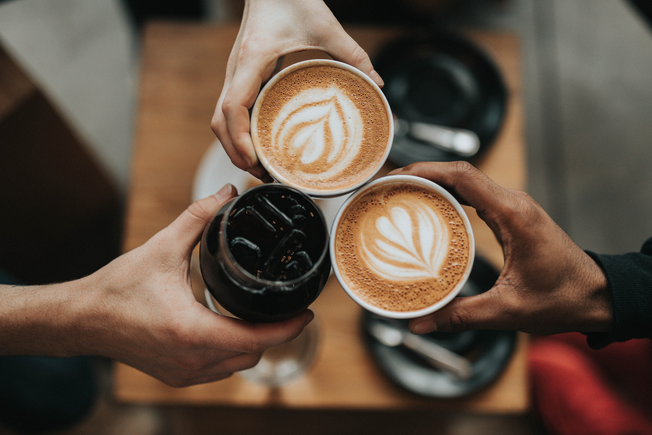
Pseudostressors
Food substances that produce a stress response
Aggravates stress and worsens sleeplessness (remember last lecture?)
Caffeine is a sympathomimetic agent
Sympathomimetics stimulate the sympathetic nervous system
This creates a pseudo stress response and makes a stress response more likely
02
Notes:
Caffiene is also known to produce a stress response. This is known as sympathomimetics, and is when something creates a pseudeostress response in which the sympathetic nervous system is stimulated. For optimum health and stress management, limit your intake of caffeine, fats, sugars, and especially soft drinks. Excessive caffeine in your diet can lead to feelings of restlessness or nervousness (the "jitters") as well as a racing heartbeat, tremors, sleep disturbances, and nausea. Gradually reduce or eliminate the amount of caffeine you consume in a day.
Alcohol constricts metabolism and your bodies endurance, which makes maintaining a healthy lifestyle more difficult. This can contribute to overall energy loss, and weight gain, as alcohol sugars are converted into fatty acids and often require increased conditioning to maintain weight. Alcohol also inhibits the absorption of nutrients such as B12, folic acid and zinc, and causes dehydration.

Slide 13
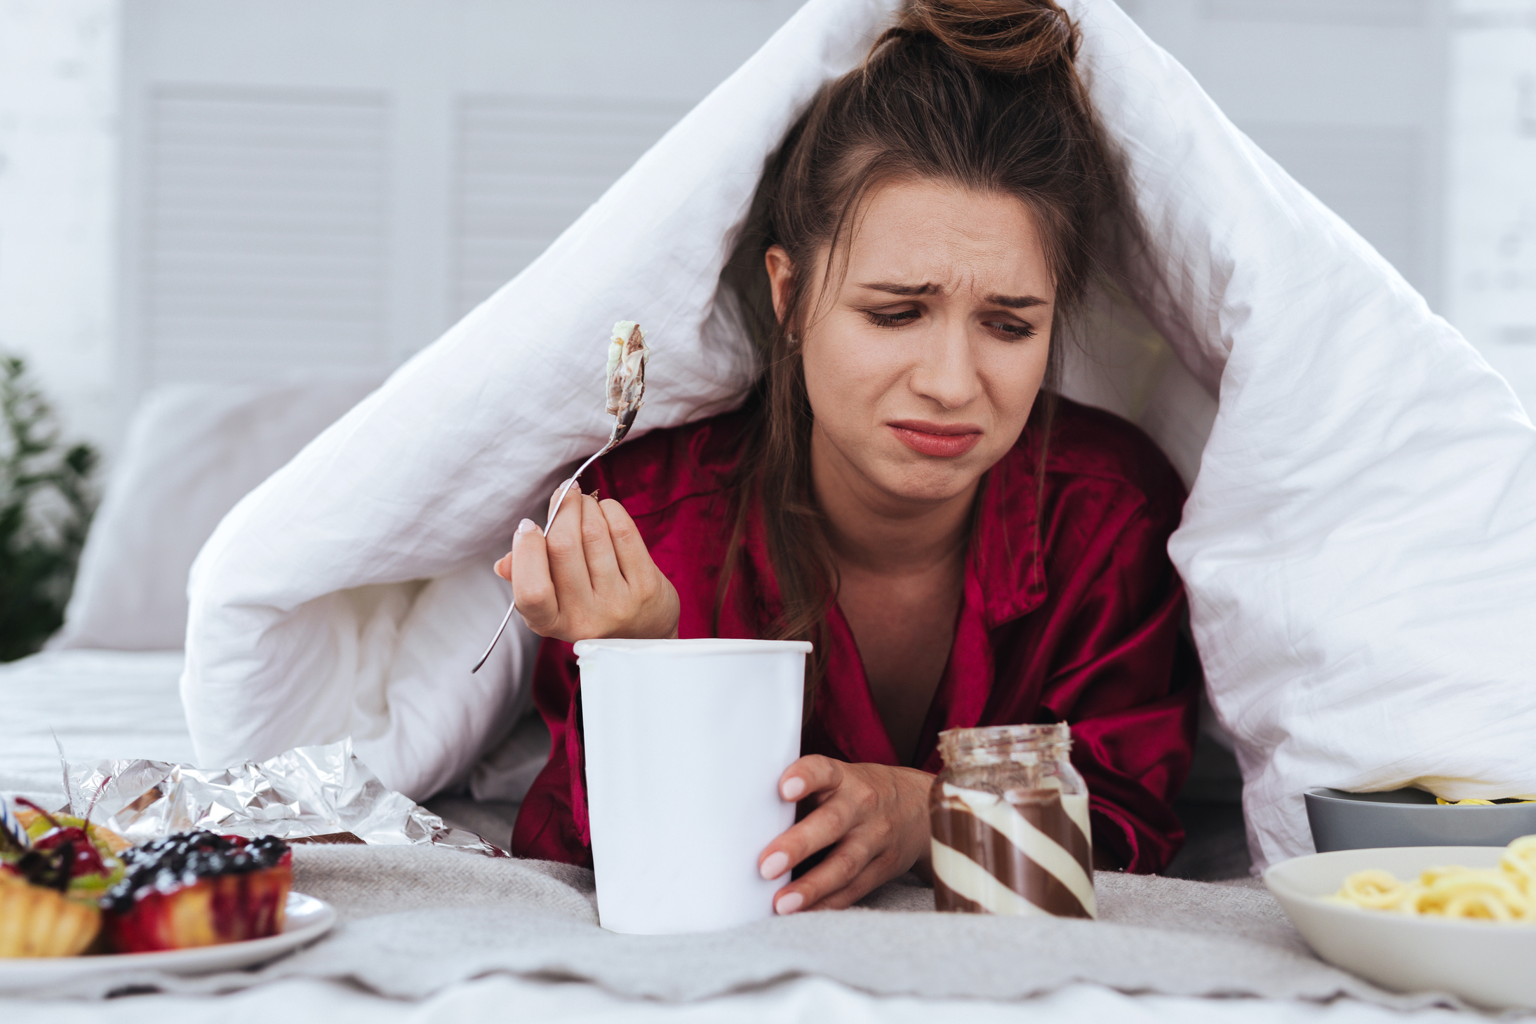
Sugar and Stress Relationship
06
Depression
Addiction to Sugar
Anxiety
Learning and memory
Notes:
Depression: high blood sugar followed by a crash may accentuate the symptoms of mood disorders. Research has tied heavy sugar consumption to an increased risk of depression and worse outcomes in individuals with schizophrenia. Sugar suppresses activity of a hormone called BDNF that is low in individuals with depression and schizophrenia.
Addiction: Addictive potential of sugar. Both drugs and, to a lesser extent, sugar and processed junk foods flood the brain with the feel-good chemical dopamine,
Anxiety: worsen anxiety symptoms and impair the body’s ability to cope with stress. A sugar high and subsequent crash can cause shaking and tension, which can make anxiety worse. Learning and memory: Sugar may also compromise cognitive abilities such as learning and memory. The high sugar diet caused insulin resistance, which in turn damaged communications between brain cells that fuel learning and memory

Slide 14
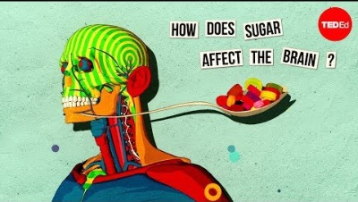
Notes:
https://youtu.be/lEXBxijQREo?t=7

Slide 15
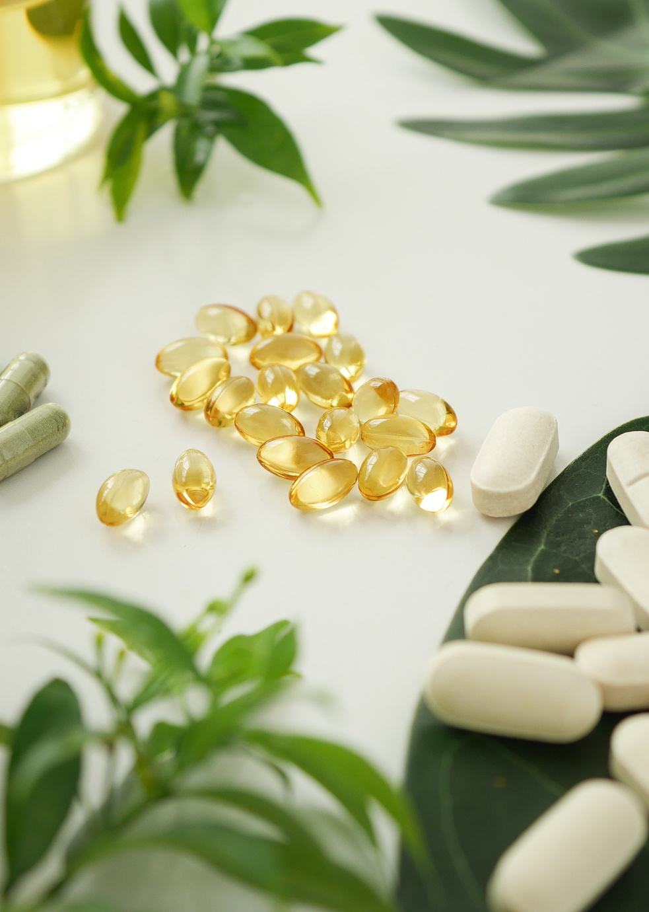
Vitamins and Minerals
Chronic stress depletes vitamins that are needed for production of adrenal hormones
Vitamin depletion can worsen the stress response, creating a vicious circle
Stress interferes with calcium absorption and interferes excretion of potassium, zinc, copper, and magnesium
Salt can increase blood pressure, resulting in even greater pressures during stress
06
Notes:
Calcium: Depletion affects the central nervous system. Low levels of calcium cause nervousness, apprehension, irritability, and numbness.
Potassium maintains acid/alkaline balance in your blood. Cortisol uses potassium, which is why clinically depressed people show remarkably higher serum cortisol levels and greatly reduced potassium levels. Depletion is frequently associated with depression, tearfulness, weakness, and fatigue
Zinc promotes proper nerve, immune and digestive health and boosts immunity. Zinc is often badly depleted in stressed people, which causes copper to be imbalanced (copper and zinc are antagonistic equalizers for each other). Inadequacies result in apathy, lack of appetite, and lethargy. When zinc is low, copper in the body can increase to toxic levels, resulting in paranoia and fearfulness.
Copper is regulated by cortisol and is vital to immune function. It is an essential mineral that sustains healthy skin and tissue, especially the heart. Copper is a significant factor in stress-induced anti-inflammatory response. Yet stressed bodies are often overloaded with copper because it displaces the missing zinc.
Magnesium helps convert blood sugar to energy. It regulates sleep and emotions that can be significantly depressed by the presence of cortisol. Deficiency can result in depressive symptoms, along with confusion, agitation, anxiety, and hallucinations, as well as a variety of physical problems.

Slide 16
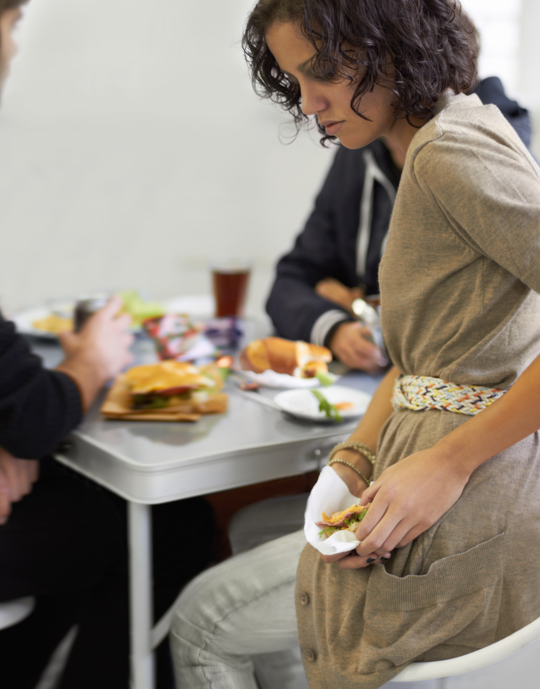
Eating Disorders
Runaway eating
The consistent use of food and food behaviors to deal with unpleasant feelings
Causes of eating
disorders
Psychological factors
Interpersonal factors
Social factors
Types
Anorexia - Self-starvation
Bulimia - Secretive cycle of binging and purging
Binge eating disorder
Periods of uncontrolled, impulsive eating beyond feeling comfortably full
02
Notes:
Eating disorders such as anorexia, bulimia, and binge eating include extreme emotions, attitudes, and behaviours surrounding weight and food issues. Research has highlighted the association between perceived stress and eating disorders, such as binge eating.
Runaway eating is the consistent use of food and food-related behaviors—such as purging or exercising excessively—to deal with unpleasant feelings and the sense that these feelings are out of control. Eating disorders are complex conditions that arise from a combination of long-standing behavioral, emotional, psychological, interpersonal, and social factors. People with eating disorders often use food and the control of food in an attempt to compensate for feelings and emotions that may otherwise seem overwhelming. Dieting, binging, and purging may begin as a way to cope with painful emotions and to feel in control of one’s life. Ultimately, these behaviors will damage a person’s physical and emotional health, self-esteem, and sense of competence and control.

Slide 17
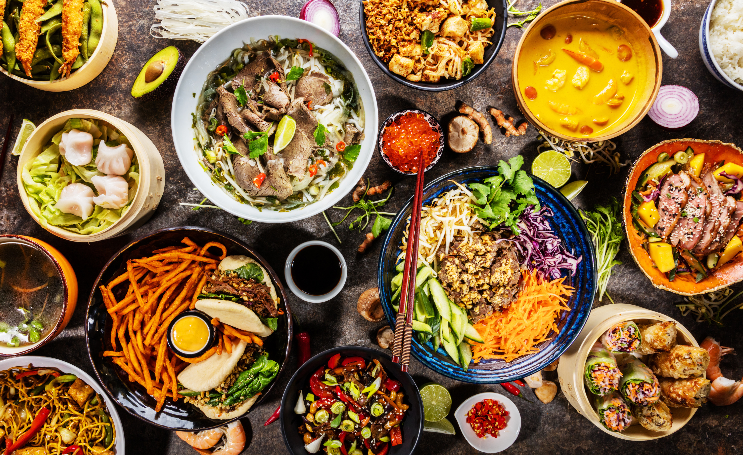
Eating to Manage Stress
Eat a balanced diet, guided by the food guide
Limit the amount of saturated fats, and increase the amount of fibre.
Add cruciferous vegetables (broccoli, Brussel sprouts, kale, cauliflower) and limit alcohol.
Be more realistic about your weight.
Limit your intake of caffeinated beverages and do not use tobacco.
06

Slide 18
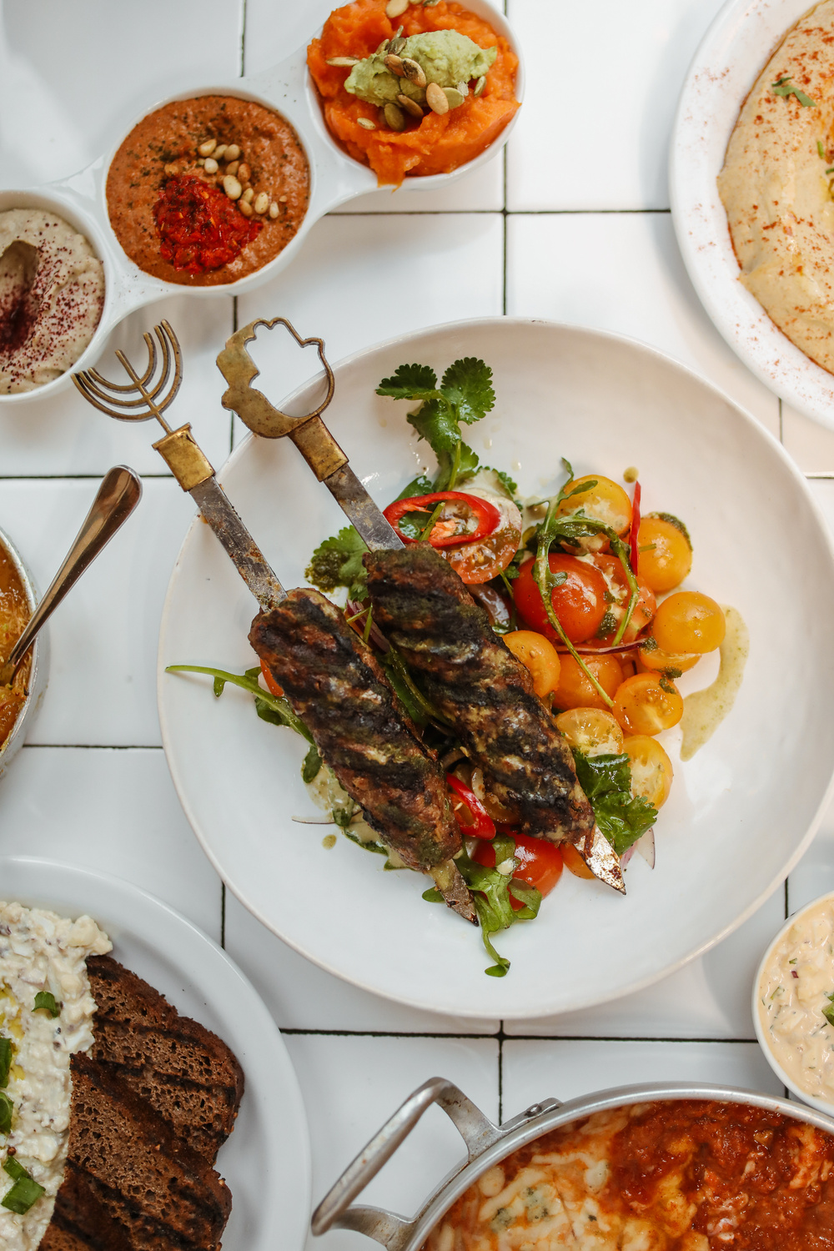
Eating to Manage Stress
Supplement your diet with vitamins, especially C and B complex.
Limit foods containing sugar, processed flour and sodium.
Practice mindful eating:
Making thoughtful food choices
Focusing attention on the meal
Chewing food slowly and thoroughly
Increases enjoyment of the meal and improves digestion.
06

Slide 19
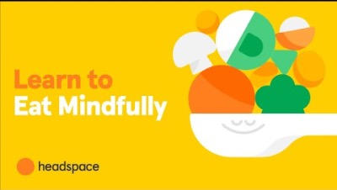
Notes:
https://www.youtube.com/watch?v=u1jRaHrpokA

Slide 20
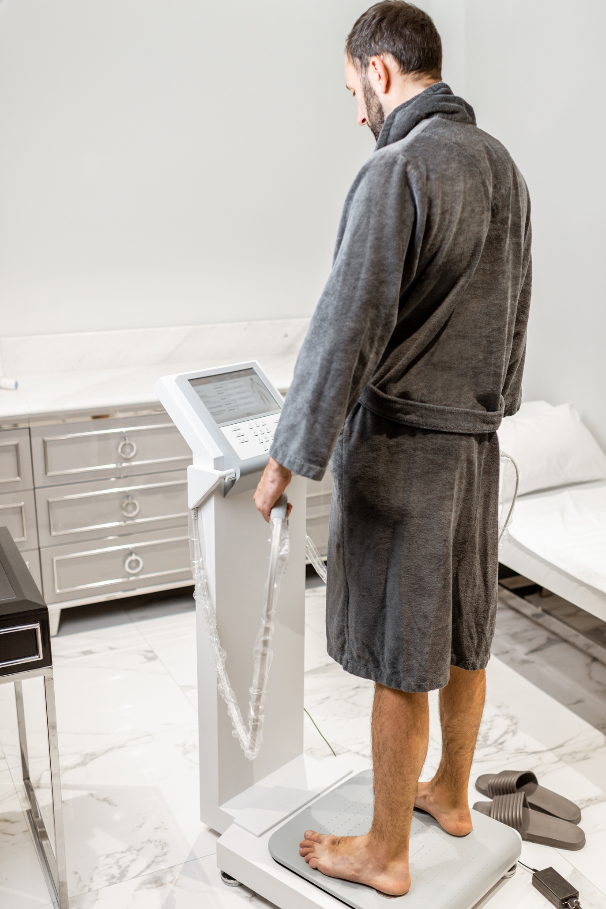
Body Composition
Body mass index, waist circumference, and waist/height ratio: calculations used to measure obesity
A healthy BMI score is between 18.5 and 24.9, but don’t use it as the only form of measurement
Being a healthy weight is important; being underweight or overweight each carry additional health risks.
06
Notes:
BMI is a good starting point, BMI needs to be used alongside other measurements to get a fuller picture of a person’s unique health risk. Lifestyle factors (such as smoking, physical activity, diet and stress levels), and blood pressure, blood sugar and blood cholesterol levels should all be considered alongside BMI to establish health risk. There is no “ideal” weight for everyone, it can depend on a variety of factors- please check with your doctor if you have any concerns about your individual weight.

Slide 21
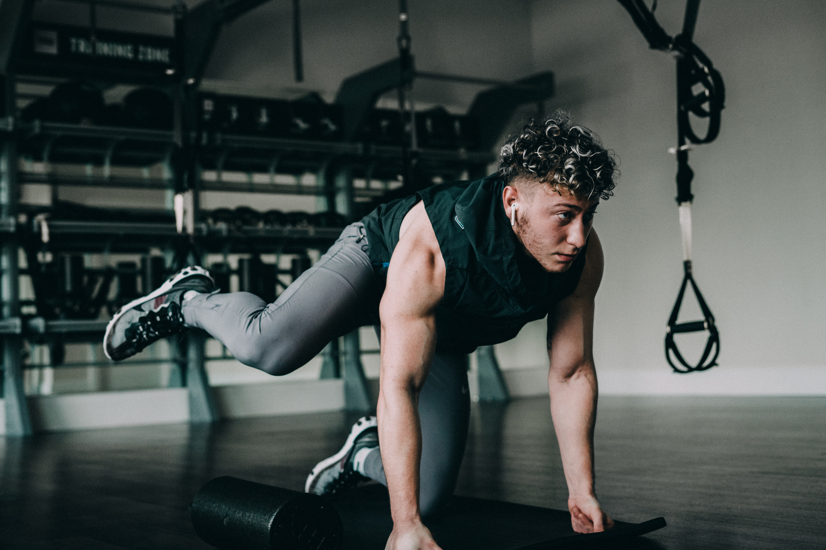
Exercise
Exercising regularly can have a positive effect on your mood by relieving the tension, anxiety, anger, and mild depression
Effective for managing stress and expending stress products
06
Notes:
Stress is known to influence health not only through its direct physiological effect, but also through its indirect effect via altered health behaviours. Maintaining a healthy lifestyle includes avoiding activities that people sometimes believe will help them relax or cope with the stress that they feel. Taking care of your body is an important strategy for preventing stress. A strong, healthy body is more resilient, more able to adapt, and less likely to experience the negative effects of stress at the mental, emotional, physical, social, and spiritual levels.

Slide 22
Physical Fitness
Consists of:
Muscular strength - Absolute maximum force that a muscle can generate
Muscular endurance - Ability to do continuous muscular work
Cardiorespiratory endurance - Ability of the circulatory system to supply oxygen to the muscles and remove waste products
Flexibility - Ability to move the joints of the body through their fullest range of motion
Body composition - Proportion of lean body mass to the percentage of body fat
Agility - Ability to move with quickness, speed & balance
06
Notes:
Stress is known to influence health not only through its direct physiological effect, but also through its indirect effect via altered health behaviours. Maintaining a healthy lifestyle includes avoiding activities that people sometimes believe will help them relax or cope with the stress that they feel. Taking care of your body is an important strategy for preventing stress. A strong, healthy body is more resilient, more able to adapt, and less likely to experience the negative effects of stress at the mental, emotional, physical, social, and spiritual levels.

Slide 23
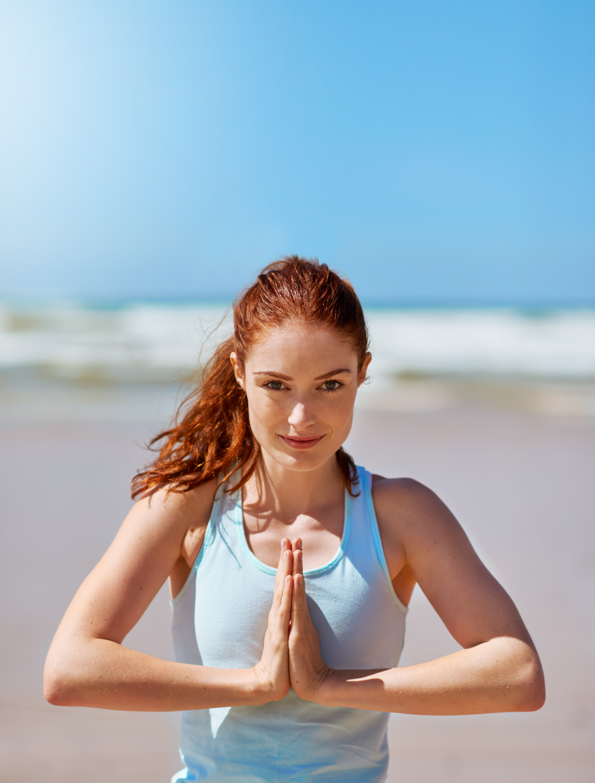
Psychological Benefits of Exercise
Having greater self-esteem
Being more positively perceived by others
Feeling more alert and able
Being a better worker
Having reduced feelings of depression and anxiety
Being better able to manage stress
06
Notes:
One reason for the psychological benefits of exercise is the release of endorphins and dopamine (brain neurotransmitters that reduce pain and give feelings of well- being)

Slide 24
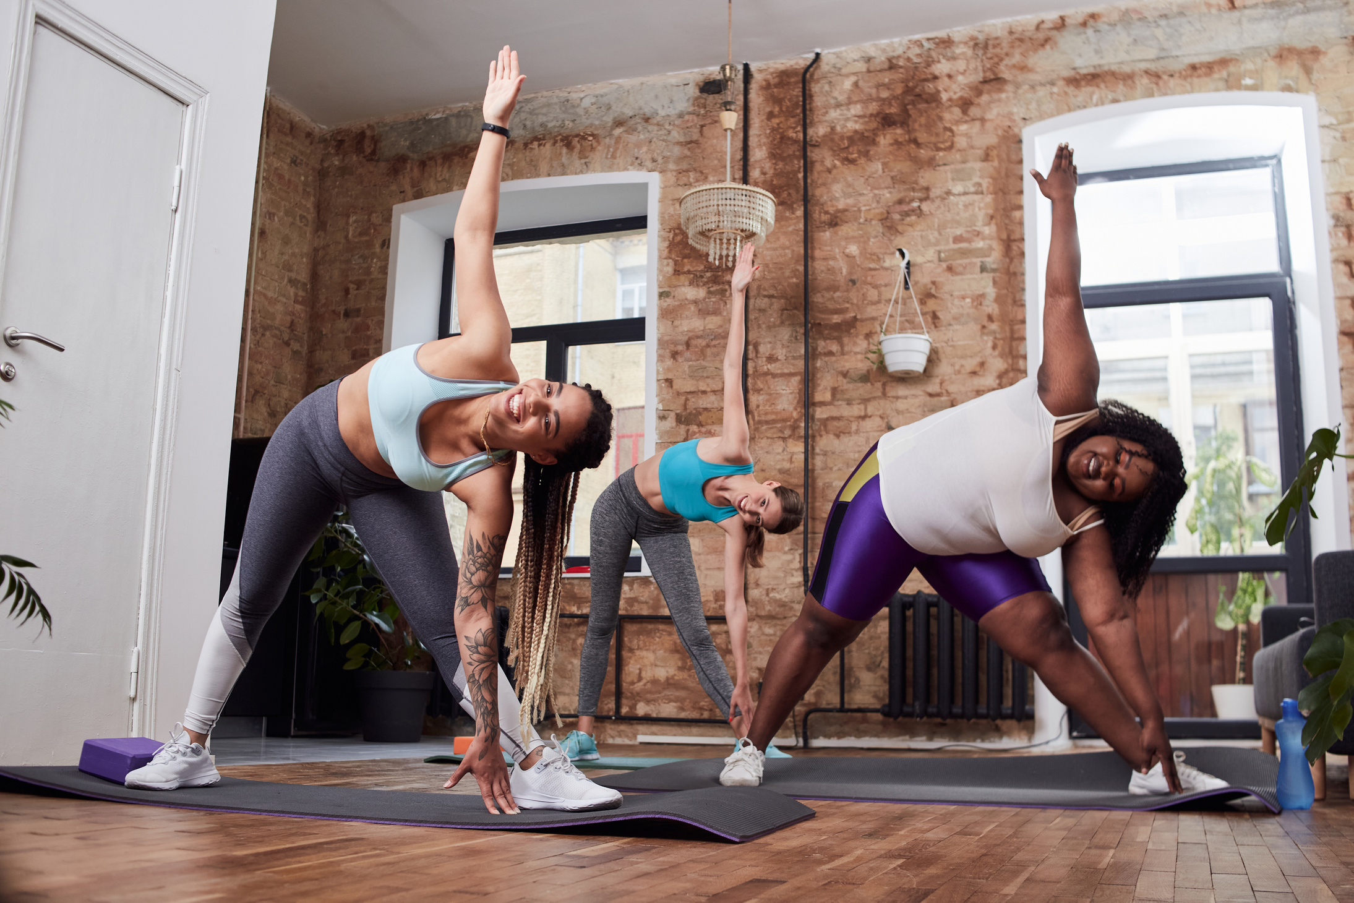
Physical Benefits of Exercise
Improves function of the lungs and circulatory system
Provides lungs with greater elasticity to breathe in more air
Delays the degenerative changes of aging
Increases production of RBCs in the bone marrow
Helps maintain normal blood pressure
Strengthens the heart muscle
Burns calories, thereby preventing health-related conditions associated with obesity
06
Notes:
Exercise is one of our most powerful stress buffers for a variety of reasons. Nothing has been found to be as generally beneficial for health and well-being as regular physical activity or exercise.
The stress response occurs when we sense the need to either run from or fight a potential threat. When we sense danger, the body automatically gears up for activity, namely running or fighting. Therefore, it eases stress to follow through on that message and participate in activities that use our fighting and running muscles—exercise. This uses excess blood sugar; muscles use the stress hormones adrenaline and cortisol; and other circulating fats in the bloodstream get used for energy. Thus, the body goes through a process similar to the stress response; that is, there is a period of arousal and hyperstimulation followed by a period of exhaustion and rest.
Exercise also generates the natural release of the mood-lifting hormones called endorphins from the brain. These “feel-good” hormones act the same way that the chemical morphine acts in the body, only without the negative side effects. Because exercise relieves stress, a physically fit person does not get sick as often due to a healthy functioning immune system.

Slide 25

Benefits of Exercise for Adults
Lower risk of early death, coronary heart disease, stroke, high blood pressure, type 2 diabetes, colon, and breast cancer
Prevention of weight gain and falls
Improved cardiorespiratory and muscular fitness
Weight loss and reduced depression
06

Slide 26
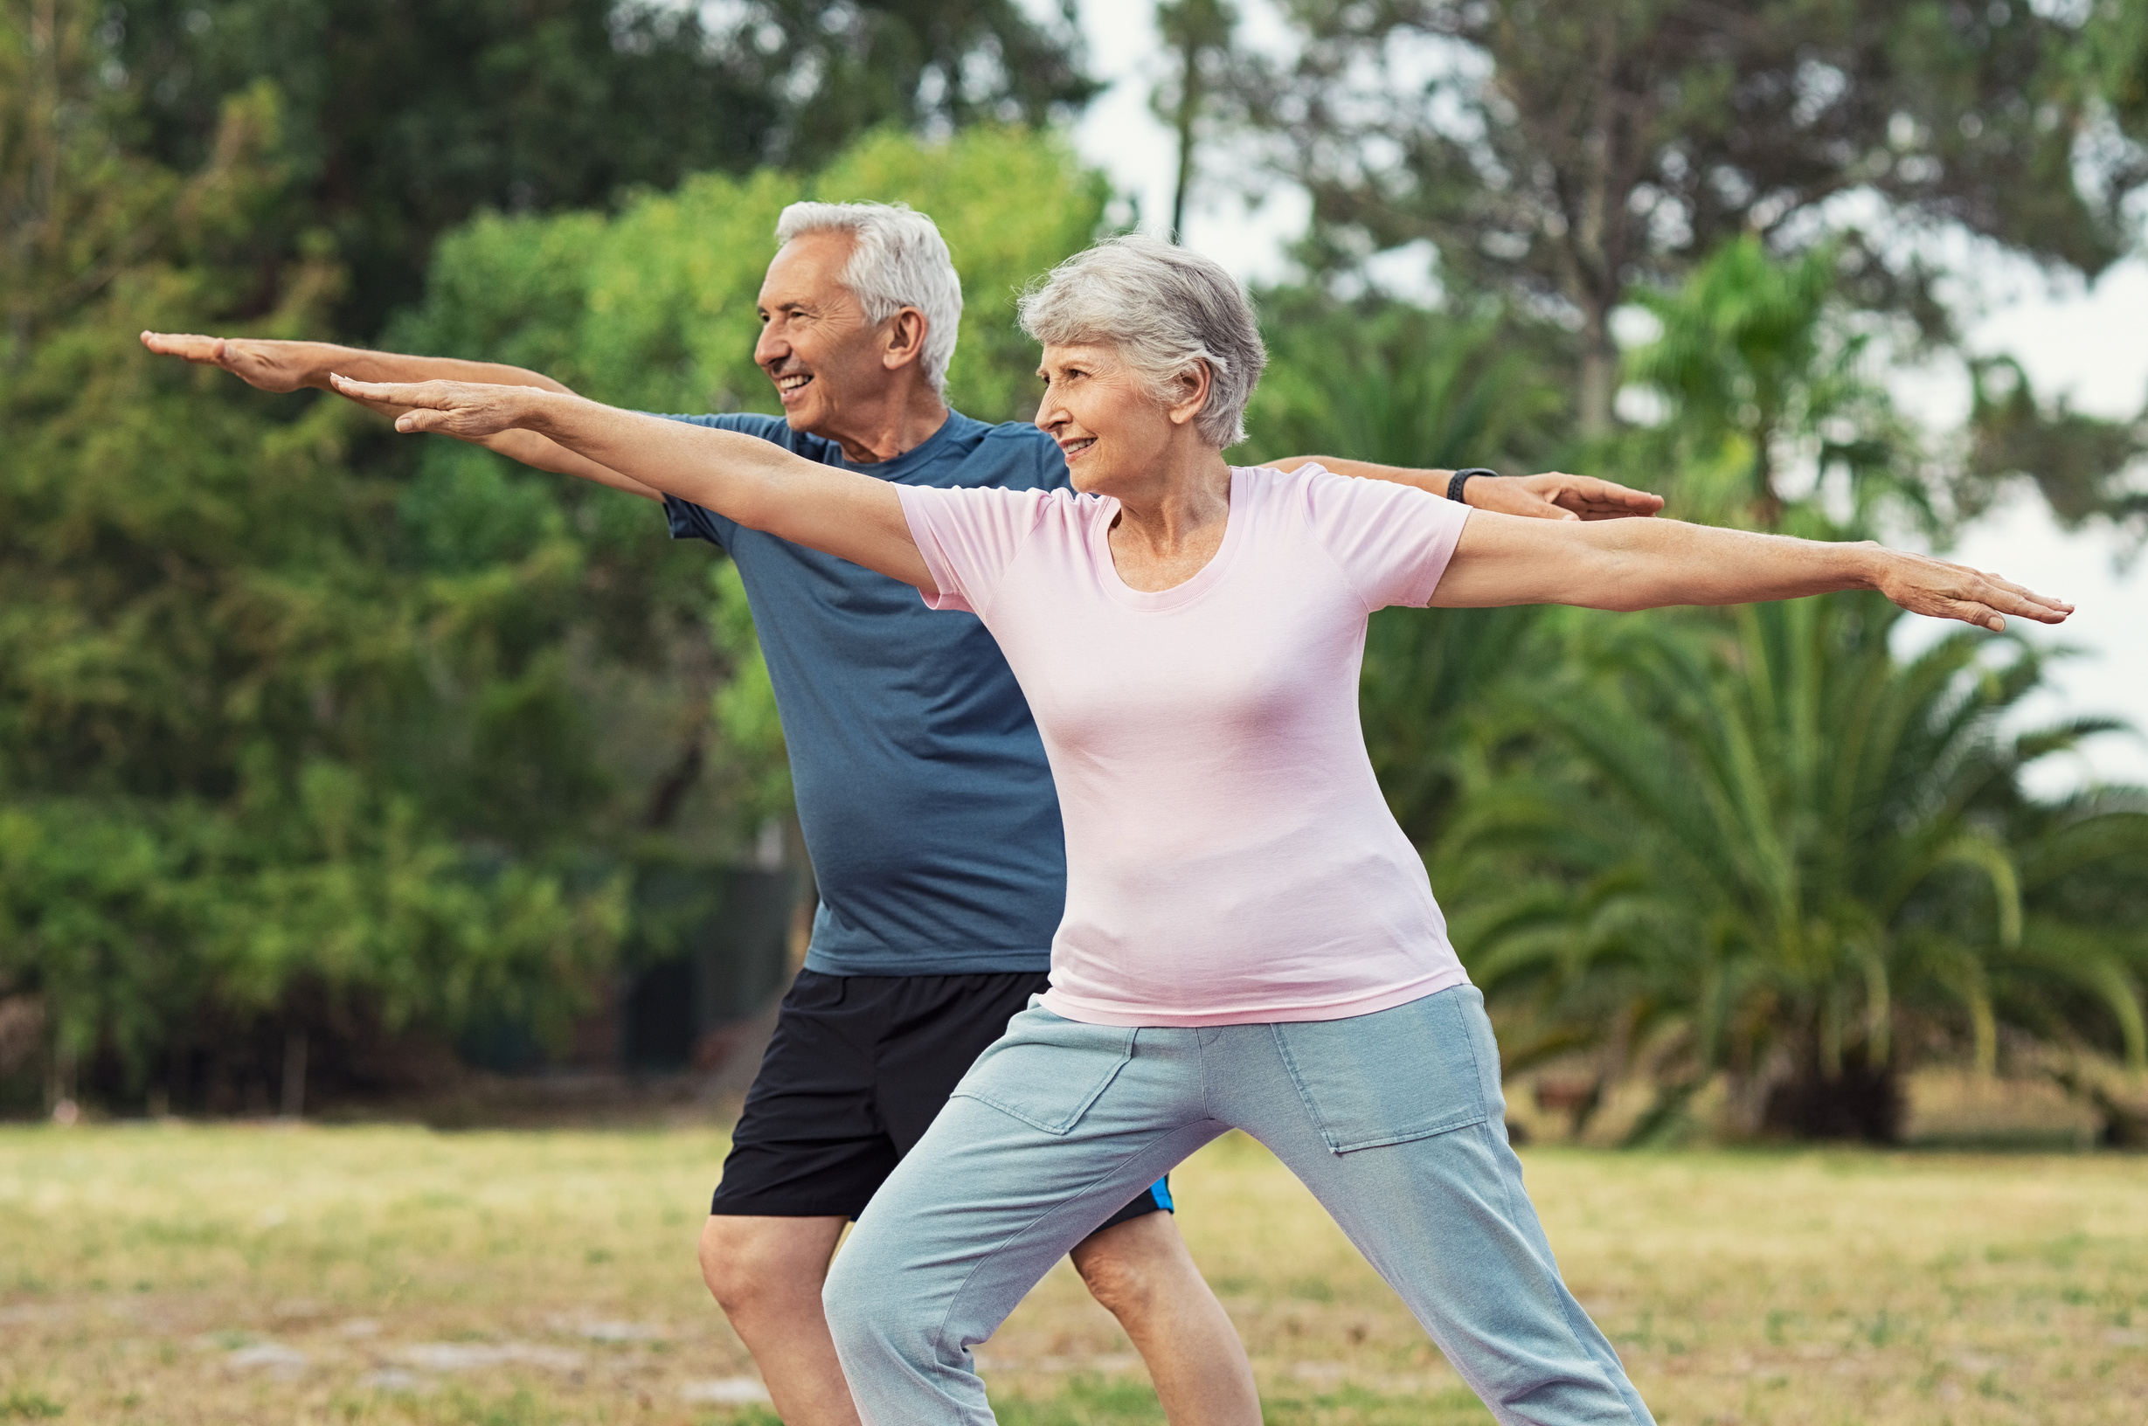
Exercise and the Elderly
Can help slow the aging process
Assists the elderly to be independent
Helps maintain balance, thereby lessening the susceptibility to falling
Enhances wellness and social health when performed with others
Combined with good nutrition, one of the strongest reducers of stress in elders
06
Notes:
Physical activity and exercise are among the most important, simplest, and cheapest approaches to anxiety treatment, especially for the elderly

Slide 27
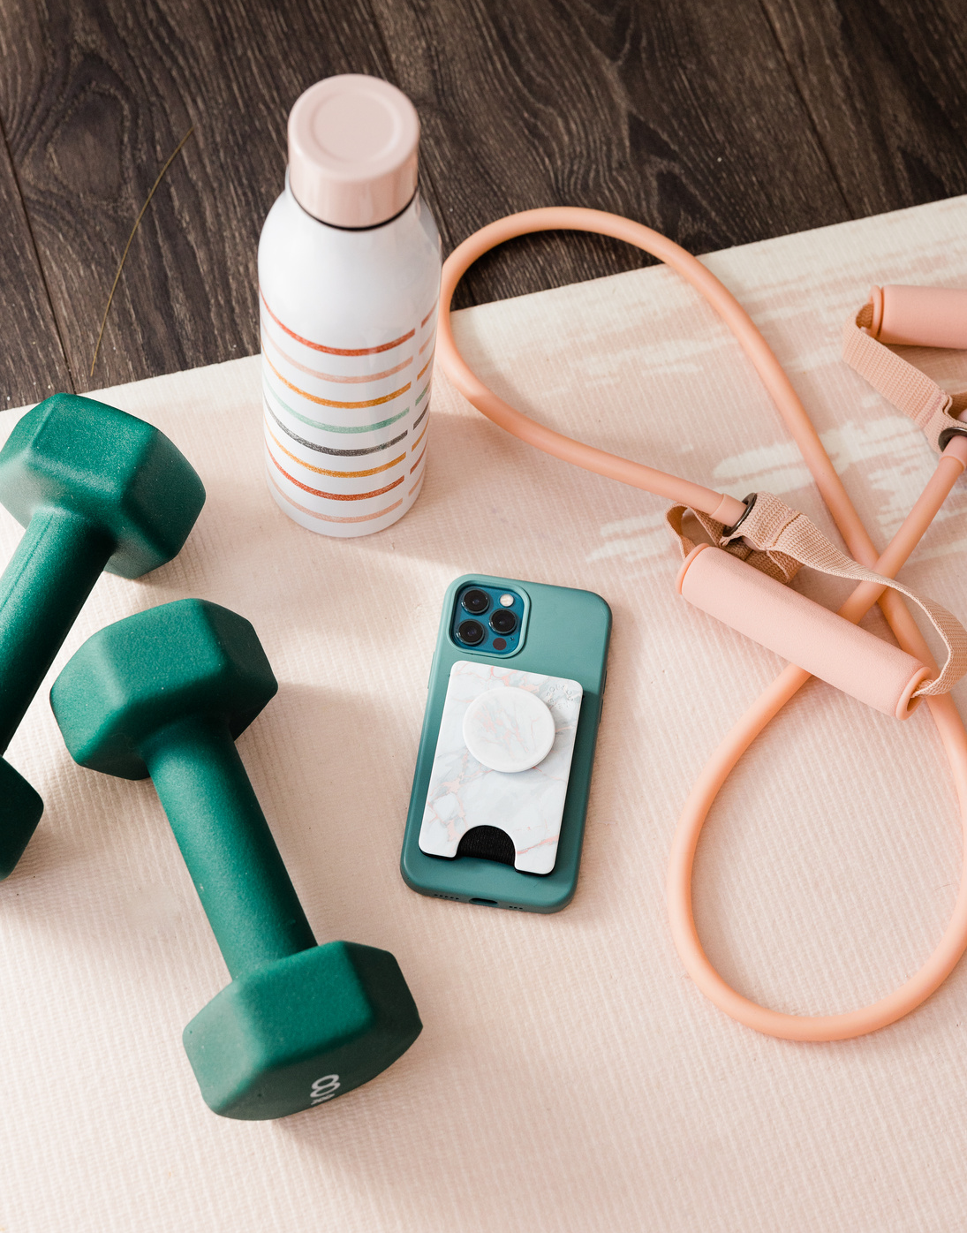
ACSM Guidelines on Quantity & Quality of Exercise
Cardiorespiratory Exercise:
Adults need at least 150 mins of moderate-intensity activity per week
People unable to meet this minimum can still benefit from some activity
Resistance Exercise:
Adults should train each major muscle group 2-3 days per week, using a variety of exercises
Wait at least 48 hours between sessions
02

Slide 28
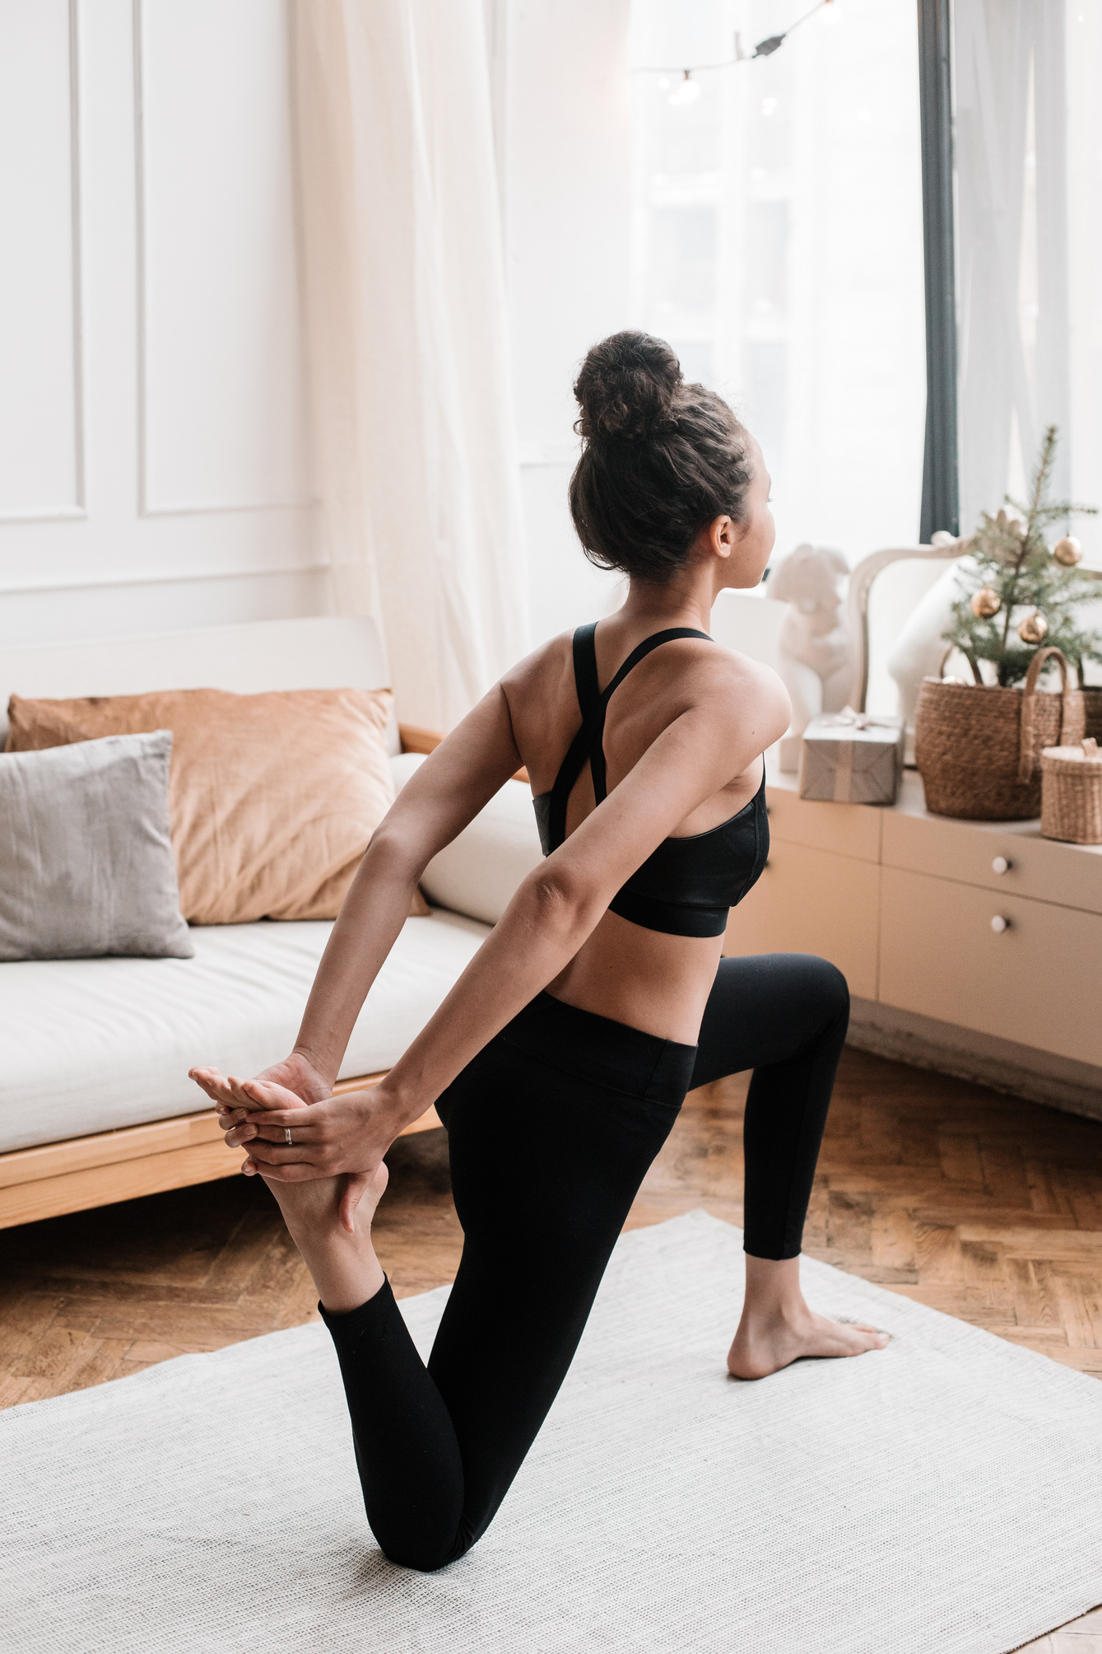
Stretching and Stress Relief
Numerous health benefits such as increased energy, blood circulation, better posture and decrease muscle pain
Stretching can have a calming and meditative effect on your mind, even if you’re not meditating
Focus on your breathing while stretching such as counting while inhaling and exhaling
02
Notes:
Stretching has numerous health benefits.
It can improve energy levels, promote blood circulation, improve posture, and possibly even decrease lower back pain.
For active adults, regular stretching increases athletic performance, reduces muscle tension, and decreases risk of injury.
It can also help you keep better posture and alignment in your spine. It helps you feel physically better, which, in turn, keeps you feeling better.
Spending a few minutes doing simple, relaxing stretches before bed can be a great way to release tension.

Slide 29
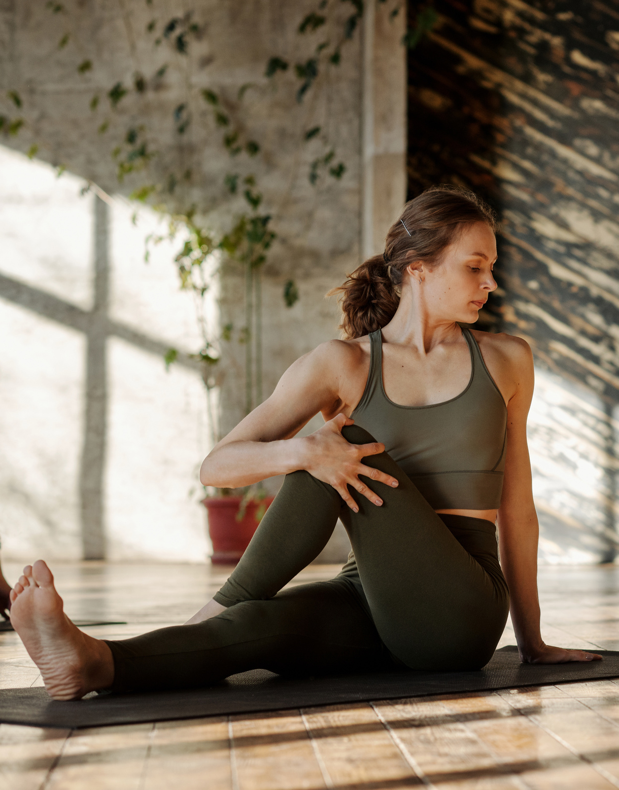
Types of Stretches
Active stretching
Holding a position by muscular contraction
Increases flexibility and strengthens the active muscles
Static stretching
Holding a position in a relaxed fashion without muscular contraction
02
Notes:
Active Stretching: In active stretching, there is no external force being provided. You are actively moving one muscle group to stretch another. Active stretches can be completed without a stretching partner or stretching accessories. If you are performing the stretch with no external force, it is an active stretch.
Passive Stretching: In passive stretching, there is an external force being provided. You are being stretched instead of actively stretching. Passive stretching can be accomplished through partner stretches, using stretching accessories and/or just using gravity to assist your stretch. If the stretch is reliant on an external force, it is a passive stretch.
Static stretching means a stretch is held in a challenging but comfortable position for a period of time, usually somewhere between 10 to 30 seconds. Static stretching is the most common form of stretching found in general fitness and is considered safe and effective for improving overall flexibility. However, many experts consider static stretching much less beneficial than dynamic stretching for improving range of motion for functional movement, including sports and activities for daily living.

Slide 30
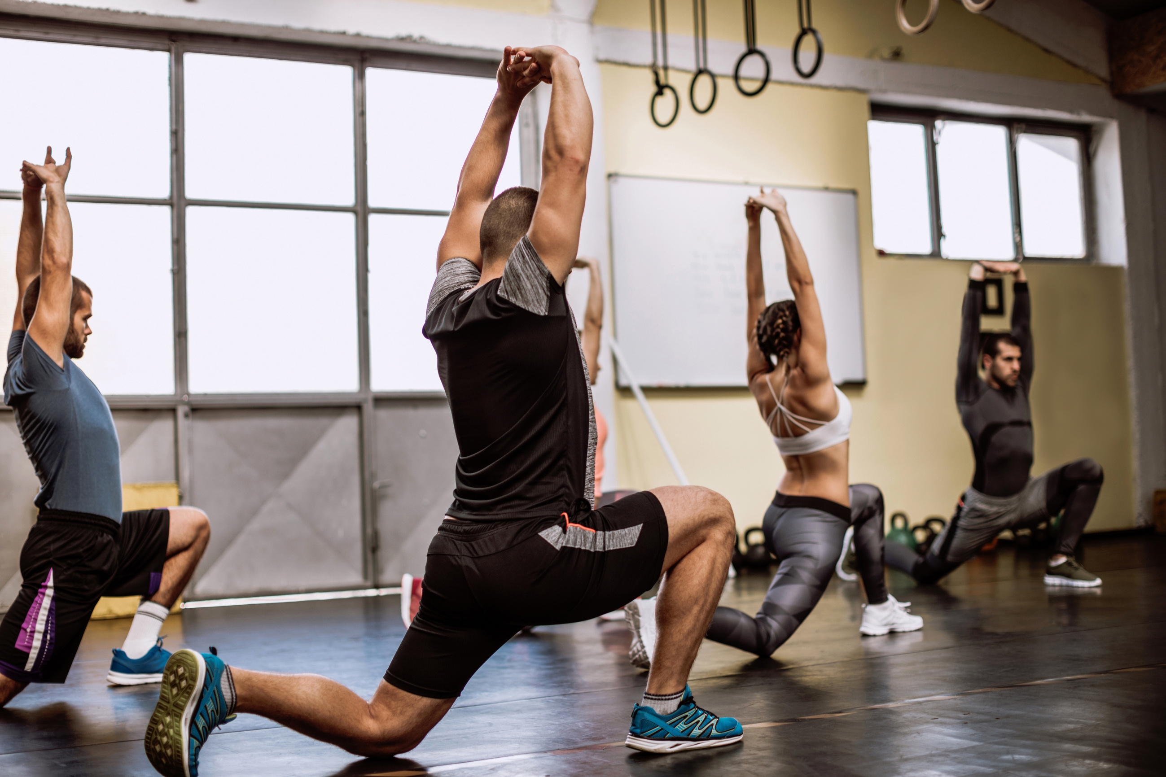
Dynamic Stretching
Active movements where joints and muscles go through a full range of motion
Can be functional and mimic the movement of the activity or sport you’re about to perform
Meant to get the body moving
Stretches aren’t held for any length of time
Helps warm up your body or get your muscles moving and ready to work
02
Notes:
More favoured type of stretching.
Dynamic stretching in appears to help in warming up the muscles, which makes the joints more mobile, the tendons more compliant, and the body more prepared to perform a specific activity. It is performed while moving, often mimicking movements of the sport or activity that you plan to perform, factoring in the explosive movements such as sprinting, jumping, or cutting. Dynamic stretching creates more heat in the body and can better prepare the body for rigorous, fast-paced activity. More evidence favors dynamic stretching over static stretching to help prevent injuries and loosen tight muscles. With dynamic stretching, it’s always good to target the primary muscle groups you plan to use.

Slide 31
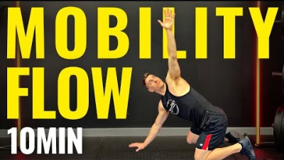
Dynamic Stretching
Notes:
Give one of these activities a try!
https://www.youtube.com/watch?v=GWbEI6moUBo

Slide 32
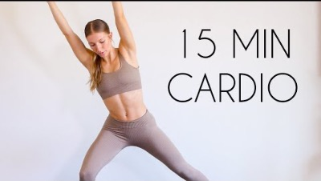
Cardio Exercise
Notes:
https://www.youtube.com/watch?v=VWj8ZxCxrYk

Slide 33
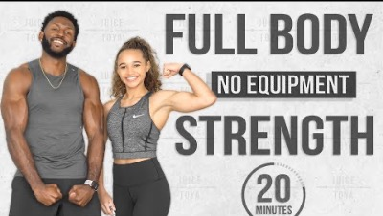
Strength Workout
Notes:
https://www.youtube.com/watch?v=Q2cMMnUuKYQ

Slide 34
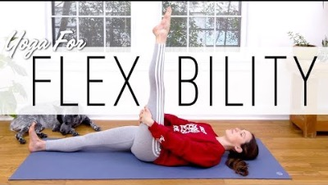
Flexibility
Notes:
https://www.youtube.com/watch?v=Yzm3fA2HhkQ

Slide 35
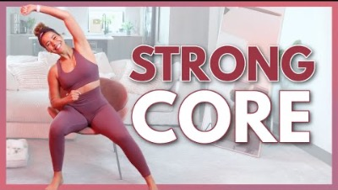
Seated Workout
Notes:
https://www.youtube.com/watch?v=FKKiUmWthv0

